Slide 1

50.039 Theory and Practice of Deep Learning W12-S2 About Diffusion Models
Matthieu De Mari

Slide 2
About this week (Week 12, an informative lecture about diffusion models)
What is a Stochastic Differential Equation?
What are typical uses of SDEs?
Can I noise images progressively using SDEs?
Can you train a denoising autoencoder model that removes SDE noise from images?
What is the diffusion process and how to use it to train diffusion models?
What are the architectures of DALL-E and Midjourney models?

Slide 3
Diffusion Models: a definition
Definition (Diffusion Models):
Diffusion models are a class of stochastic mathematical models that have typically been used to describe the random motion of particles, often referred to as “Brownian motion.“
They are widely used in various fields, such as physics, chemistry, biology, and finance, for instance to model the stochastic behaviour of particles or other quantities that exhibit random fluctuations over time.
The fundamental concept behind diffusion models is the idea of Stochastic Differential Equations (SDEs).

Slide 4
Stochastic Differential Equations (SDEs)
Definition (Stochastic Differential Equations):
Stochastic Differential Equations (SDEs) are differential equations where one or more of the terms include a random component, usually in the form of a noise term.
The randomness is often modelled using a Wiener process or Brownian motion, which is a continuous-time stochastic process characterized by a mean, a variance, and independent increments.

Slide 5
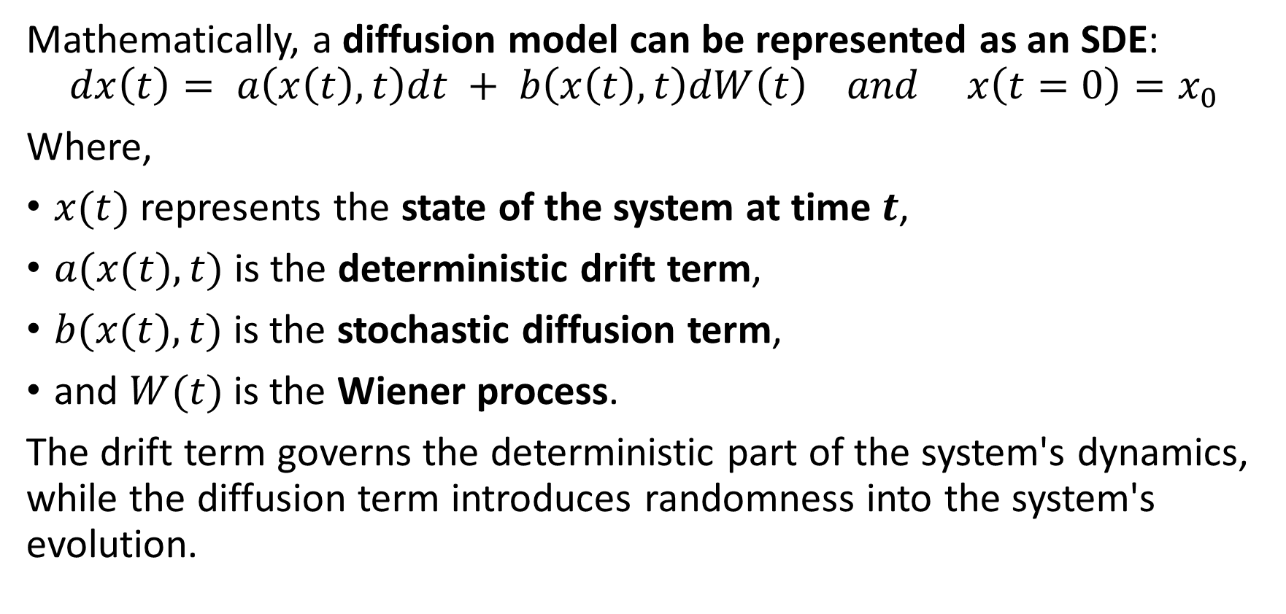
Diffusion models as SDEs
Mathematically, a diffusion model can be represented as an SDE:
$$dx\left(t\right)= a\left(x\left(t\right), t\right)dt + b\left(x\left(t\right), t\right)dW\left(t\right) and x\left(t=0\right)=x_{0}$$
Where,
$x(t)$represents the state of the system at time $t$,
$a(x(t), t)$is the deterministic drift term,
$b(x(t), t)$is the stochastic diffusion term,
and $W(t)$is the Wiener process.
The drift term governs the deterministic part of the system's dynamics, while the diffusion term introduces randomness into the system's evolution.

Slide 6
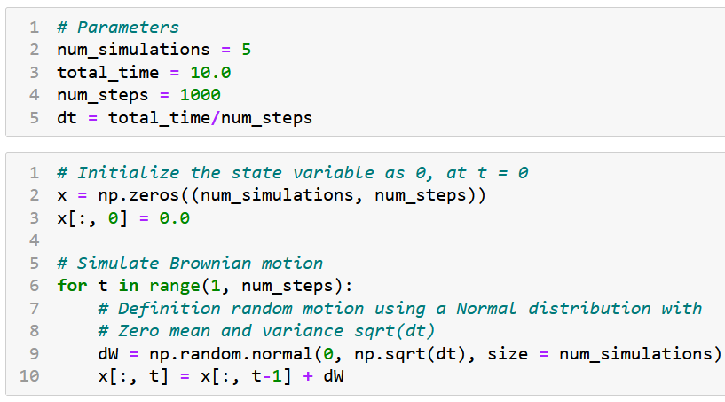
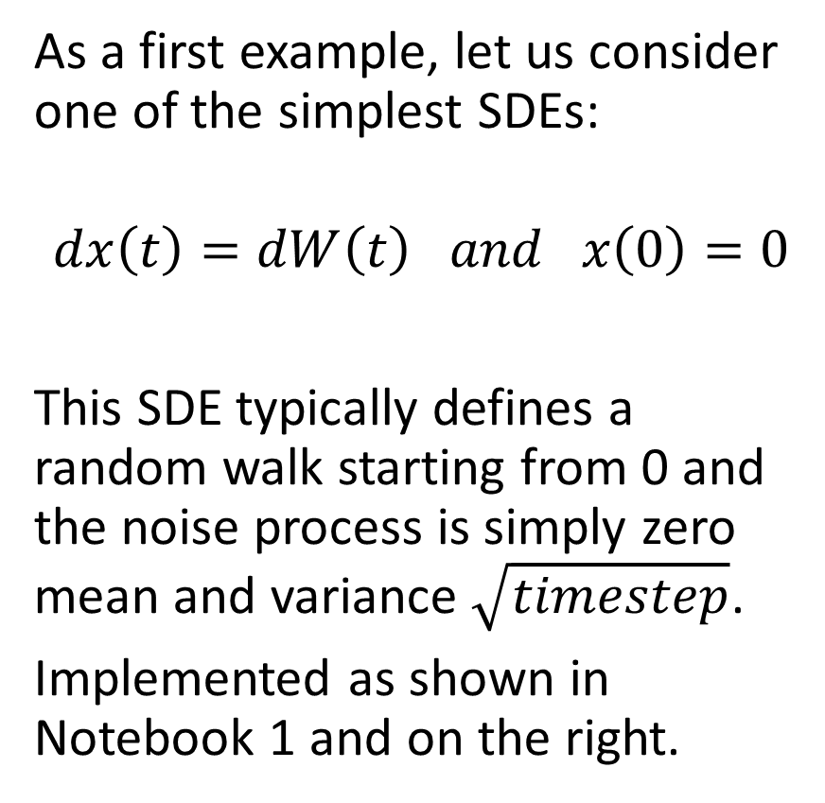
A first SDE: the Brownian motion
As a first example, let us consider one of the simplest SDEs:
$$dx\left(t\right)=dW\left(t\right) and x\left(0\right)=0$$
This SDE typically defines a random walk starting from 0 and the noise process is simply zero mean and variance $\sqrt{timestep}$.
Implemented as shown in Notebook 1 and on the right.

Slide 7
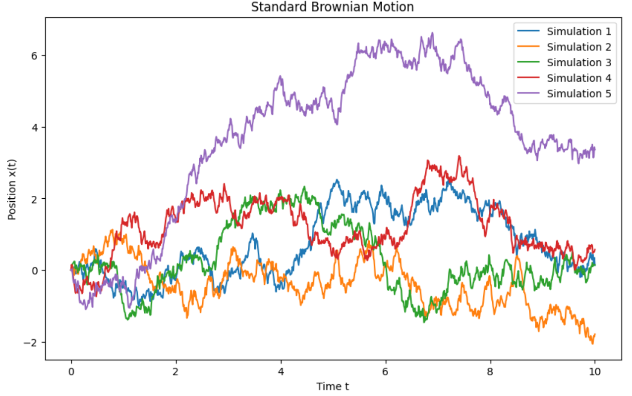
A first SDE: the Brownian motion
As a first example, let us consider one of the simplest SDEs:
$$dx\left(t\right)=dW\left(t\right) and x\left(0\right)=0$$
This SDE typically defines a random walk starting from 0 and the noise process is simply zero mean and variance $\sqrt{timestep}$.
Implemented as shown in Notebook 1 and on the right.

Slide 8
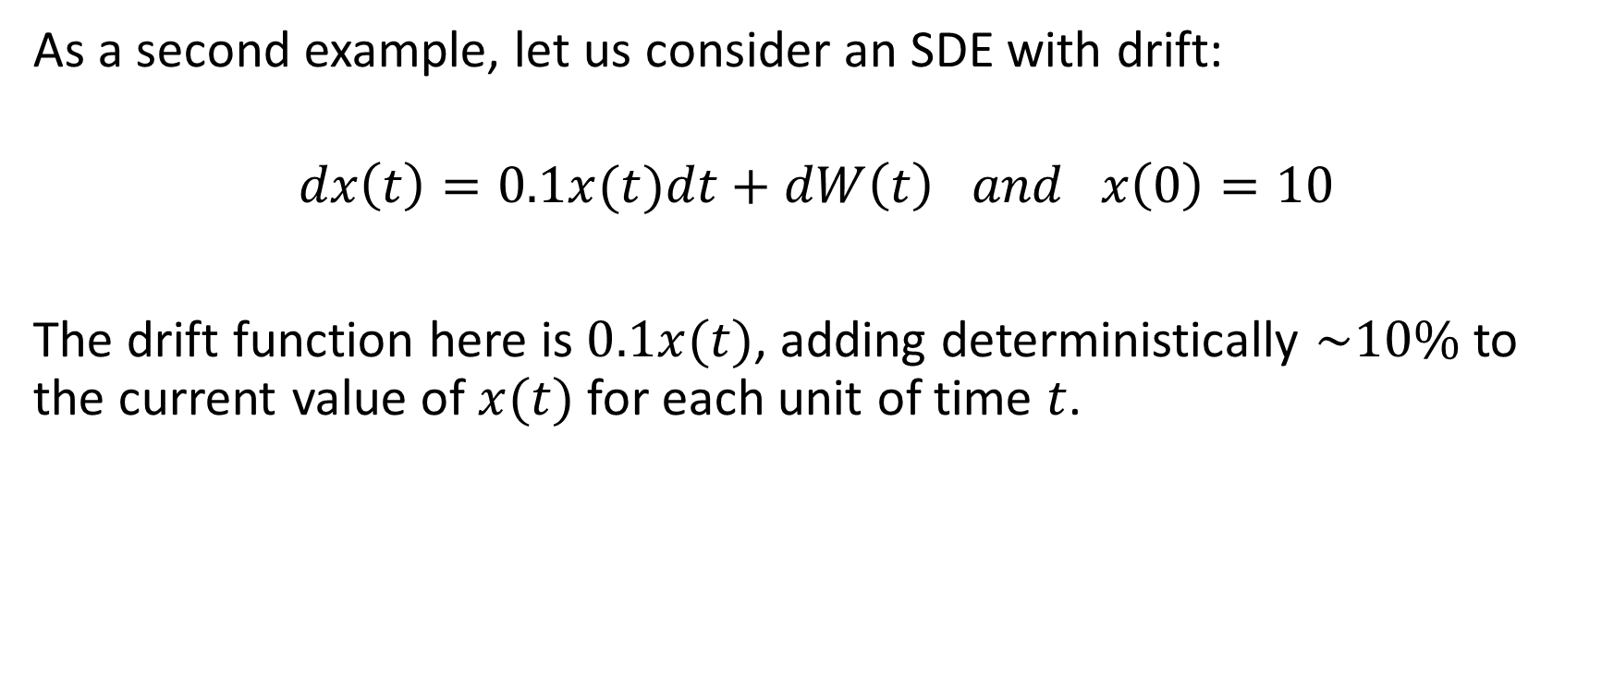
A second SDE with drift
As a second example, let us consider an SDE with drift:
$$dx\left(t\right)=0.1x(t)dt+dW\left(t\right) and x\left(0\right)=10$$
The drift function here is $0.1x(t)$, adding deterministically $\sim 10\%$to the current value of $x(t)$for each unit of time $t$.

Slide 9
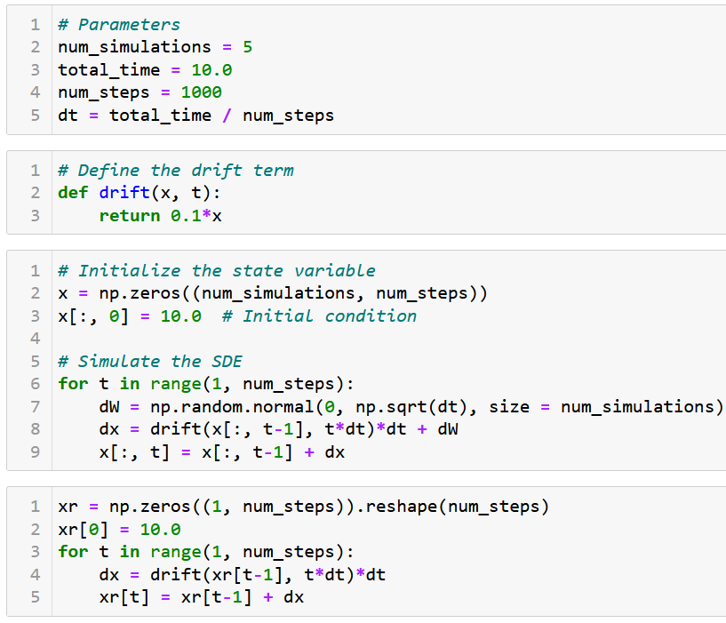
A second SDE with drift
This second SDE is typically implemented as shown.
We also show as xr, the realisation of the SDE without any Wiener motion.

Slide 10
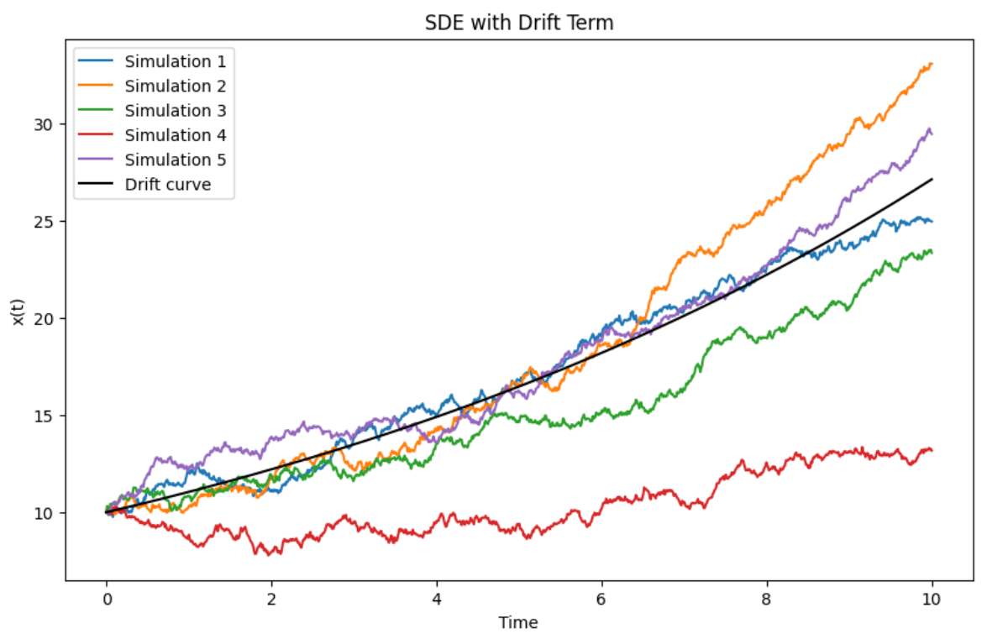
A second SDE with drift
This second SDE is typically implemented as shown.
We also show as xr, the realisation of the SDE without any Wiener motion.
Typically a 10% increase per unit of time (as is often described the US stock market), with noisy variations.
Is the stock market an SDE of some sort then?

Slide 11
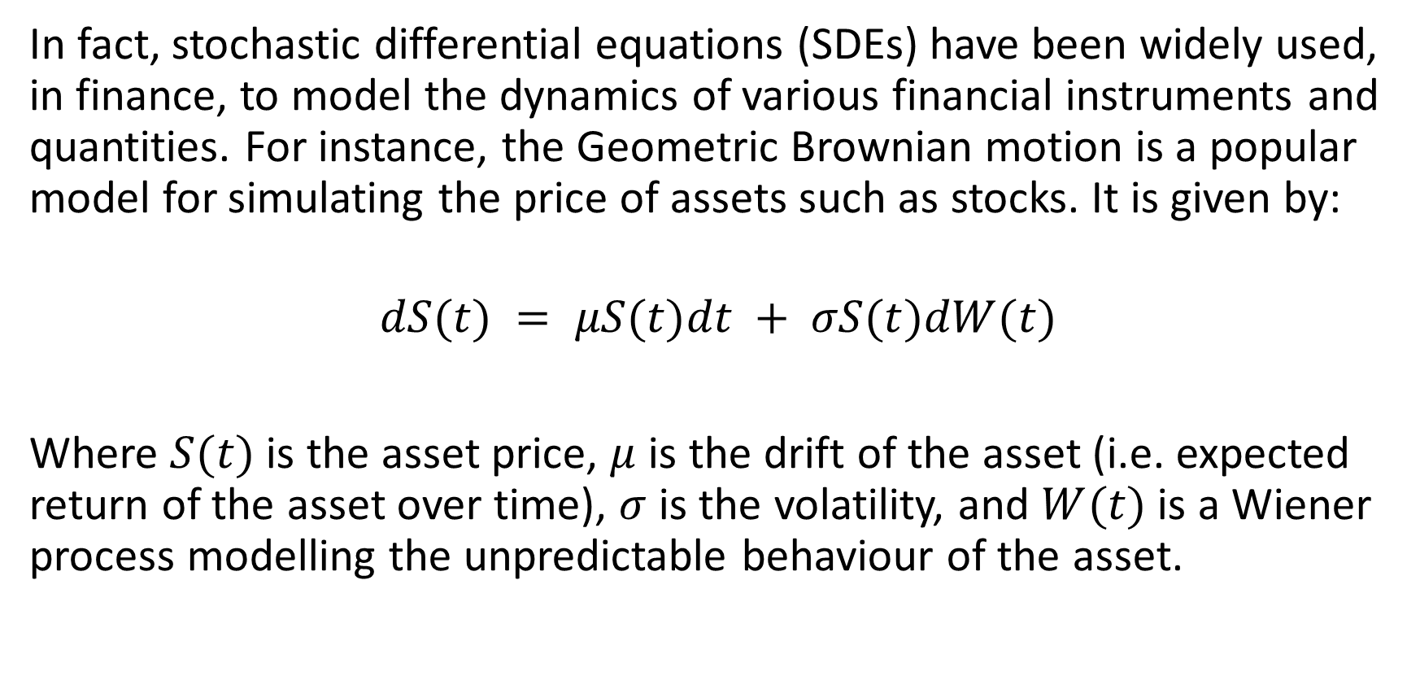
Typical examples of SDEs
In fact, stochastic differential equations (SDEs) have been widely used, in finance, to model the dynamics of various financial instruments and quantities. For instance, the Geometric Brownian motion is a popular model for simulating the price of assets such as stocks. It is given by:
$$dS(t) = μS(t)dt + σS(t)dW(t)$$
Where $S(t)$is the asset price, $μ$ is the drift of the asset (i.e. expected return of the asset over time), $σ$ is the volatility, and $W(t)$is a Wiener process modelling the unpredictable behaviour of the asset.

Slide 12
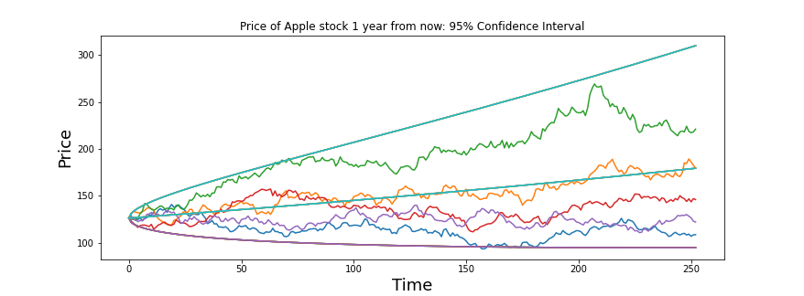
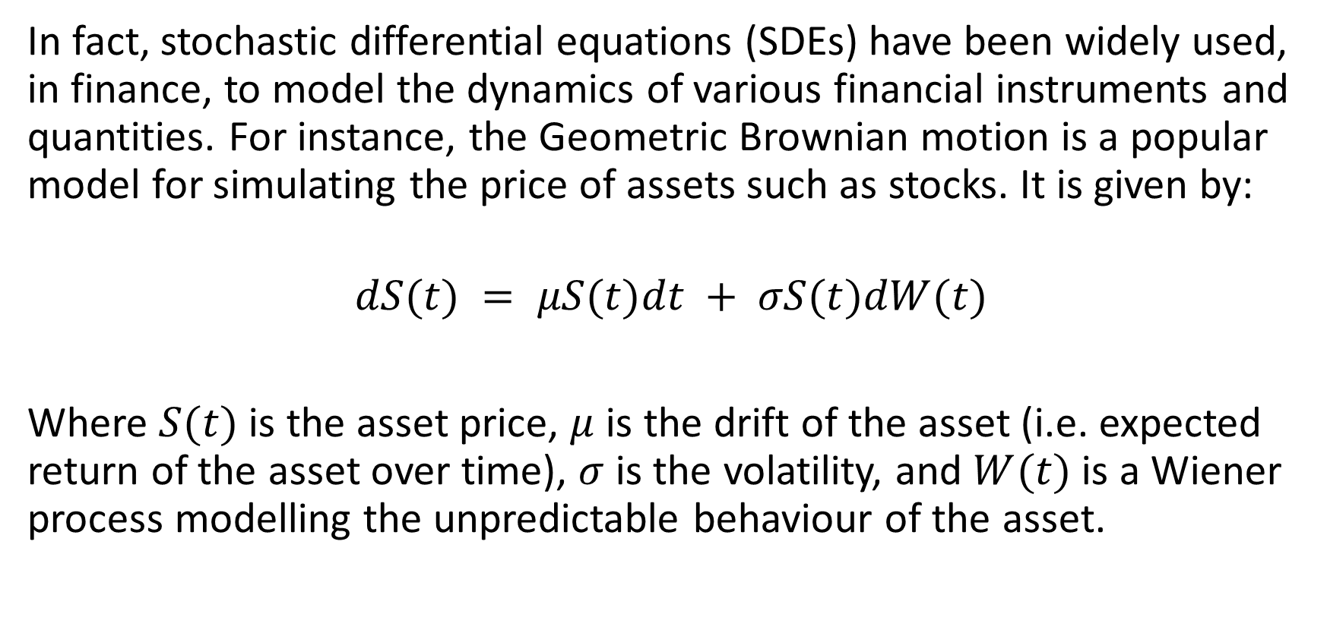
Typical examples of SDEs
In fact, stochastic differential equations (SDEs) have been widely used, in finance, to model the dynamics of various financial instruments and quantities. For instance, the Geometric Brownian motion is a popular model for simulating the price of assets such as stocks. It is given by:
$$dS(t) = μS(t)dt + σS(t)dW(t)$$
Where $S(t)$is the asset price, $μ$ is the drift of the asset (i.e. expected return of the asset over time), $σ$ is the volatility, and $W(t)$is a Wiener process modelling the unpredictable behaviour of the asset.

Slide 13
A first task, denoising images
Task: take images from MNIST and noise them. The model should try its best to denoise them an get back to the original image.
Dataset: MNIST images, noised (inputs) and original (output).
Model: an encoder-decoder model of some sort, similar to an autoencoder (almost).
Loss and training procedure: As in the case of autoencoders, a simple MSE loss and a basic training procedure with Adam optimizer will do.

Slide 14
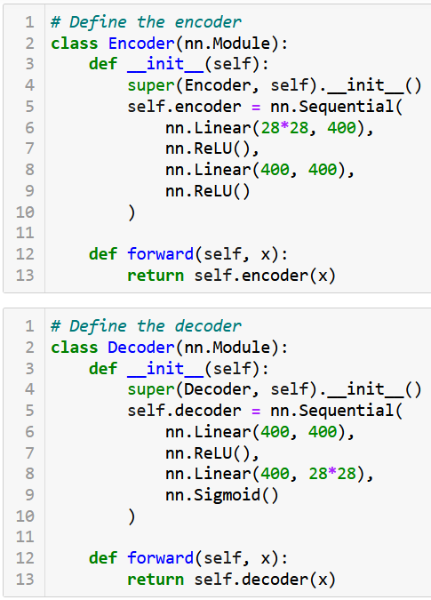
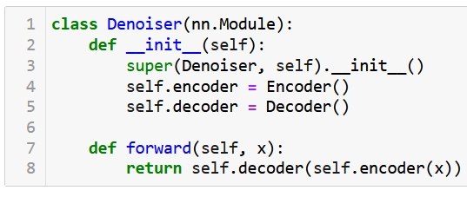
A first task, denoising images
For simplicity, we consider an encoder-decoder model, similar to our autoencoder in W10-NB1, running on linear layers.

Slide 15
A first task, denoising images
For simplicity, we consider an encoder-decoder model, similar to our autoencoder in W10-NB1, running on linear layers.
And a basic training procedure…

Slide 16
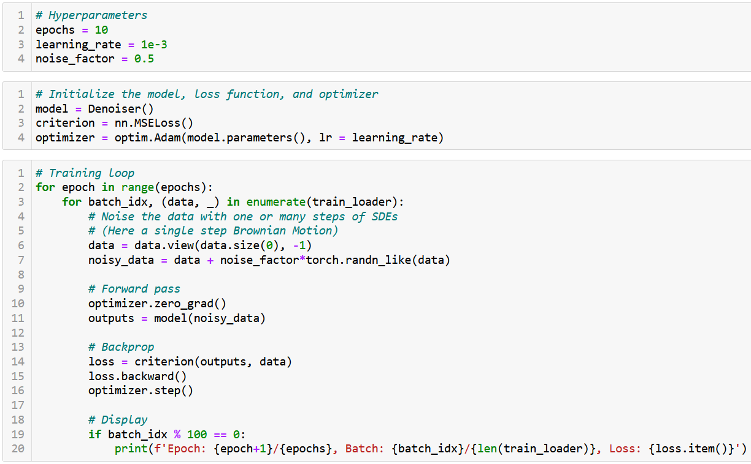

Slide 17
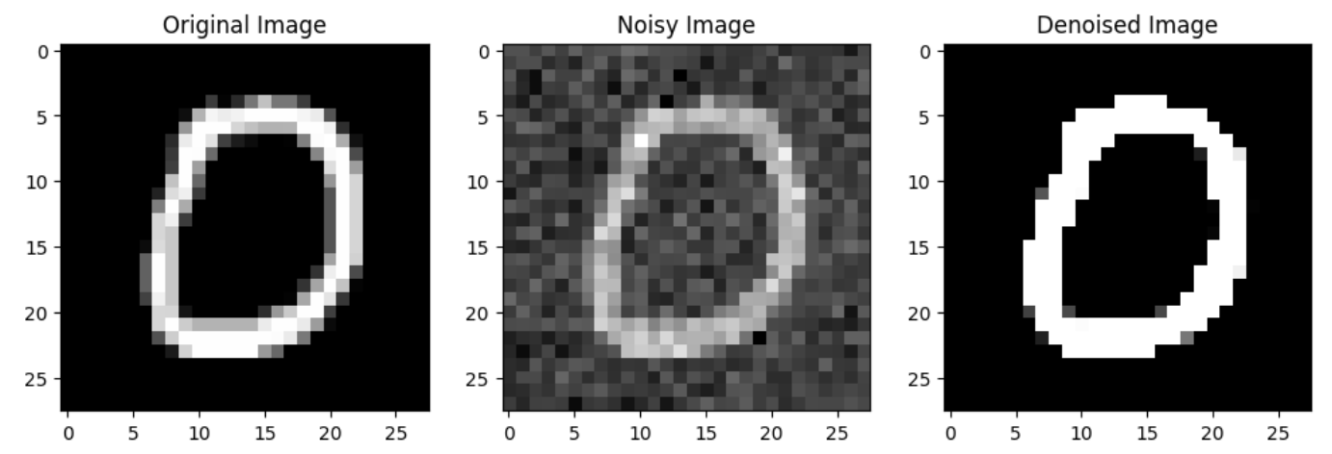
A first task, denoising images
The model trains and seems able to denoise lightly noised images.

Slide 18
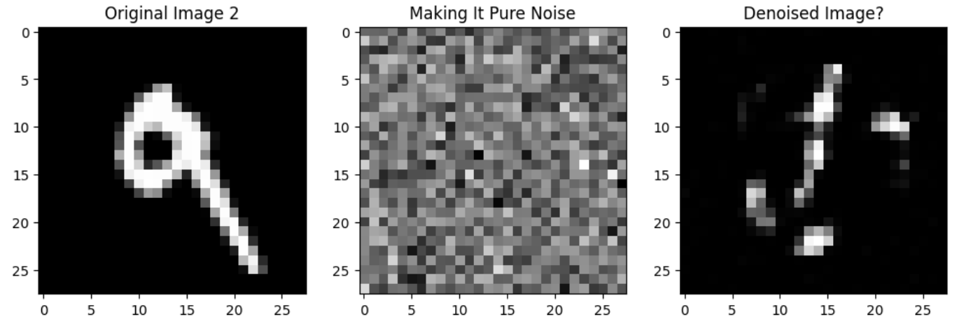
A first task, denoising images
The model trains and seems able to denoise lightly noised images.
Could it denoise a pure noise image, though? Not really.

Slide 19
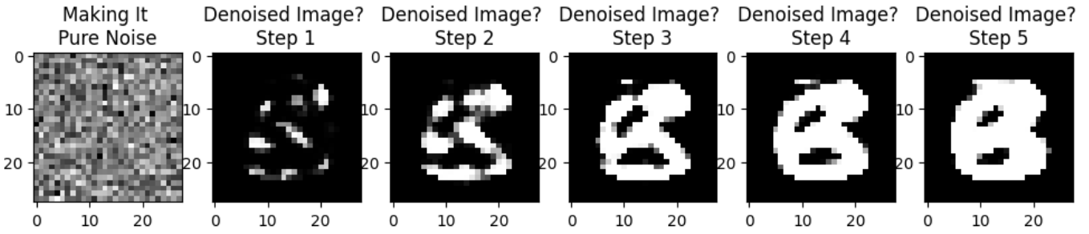
A first task, denoising images
The model trains and seems able to denoise lightly noised images.
Could it denoise a pure noise image, though? Not really.
What if we used the model many (e.g. 5) times in a row on our full noise image? Eventually would obtain something B&W in the likes of MNIST but somehow non-sensical in terms of shapes…?!

Slide 20
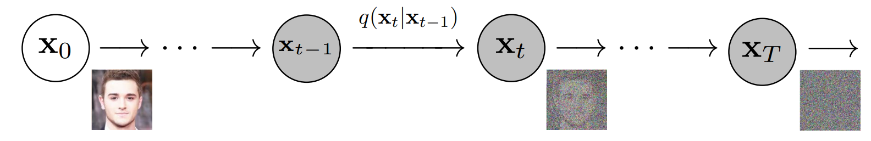
A (not so?) crazy idea
Idea: what if instead of noising the image in one step, and denoising it in one call of the model, we try iterative noising and denoising?
(Somehow similar to the idea of modifying the image iteratively during the iterated versions of our attacks in W5!)

Slide 21
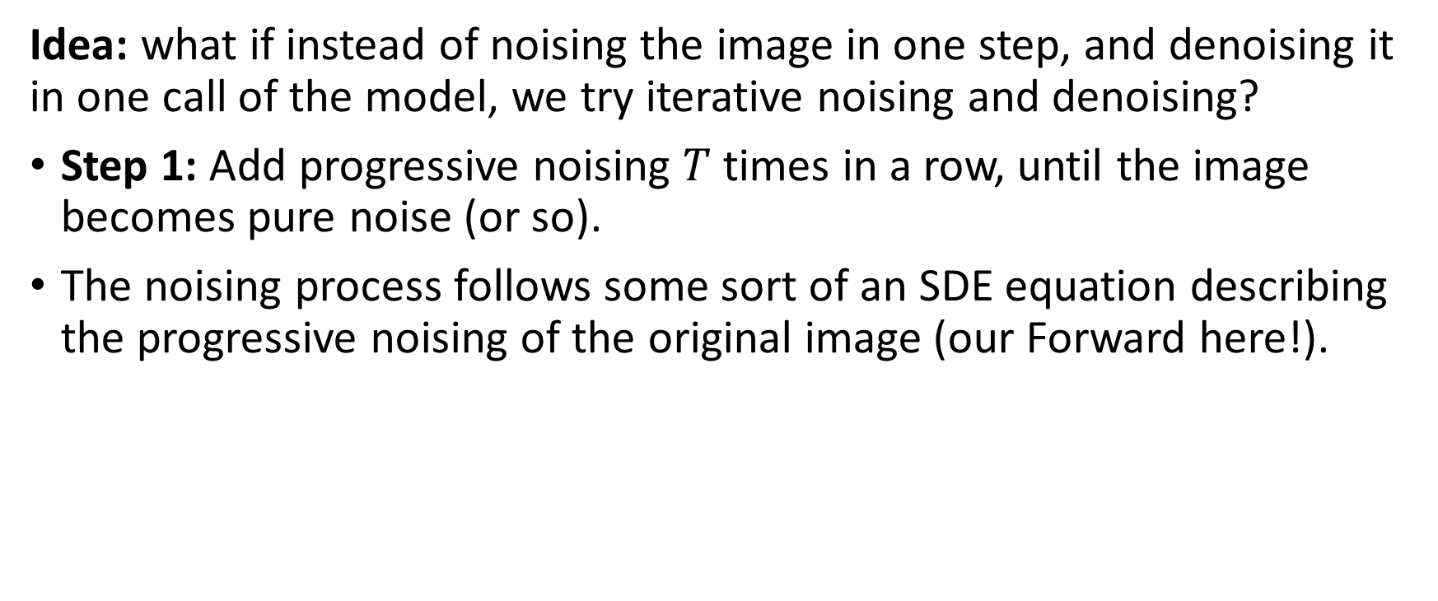
A (not so?) crazy idea
Idea: what if instead of noising the image in one step, and denoising it in one call of the model, we try iterative noising and denoising?
Step 1: Add progressive noising $T$ times in a row, until the image becomes pure noise (or so).
The noising process follows some sort of an SDE equation describing the progressive noising of the original image (our Forward here!).

Slide 22
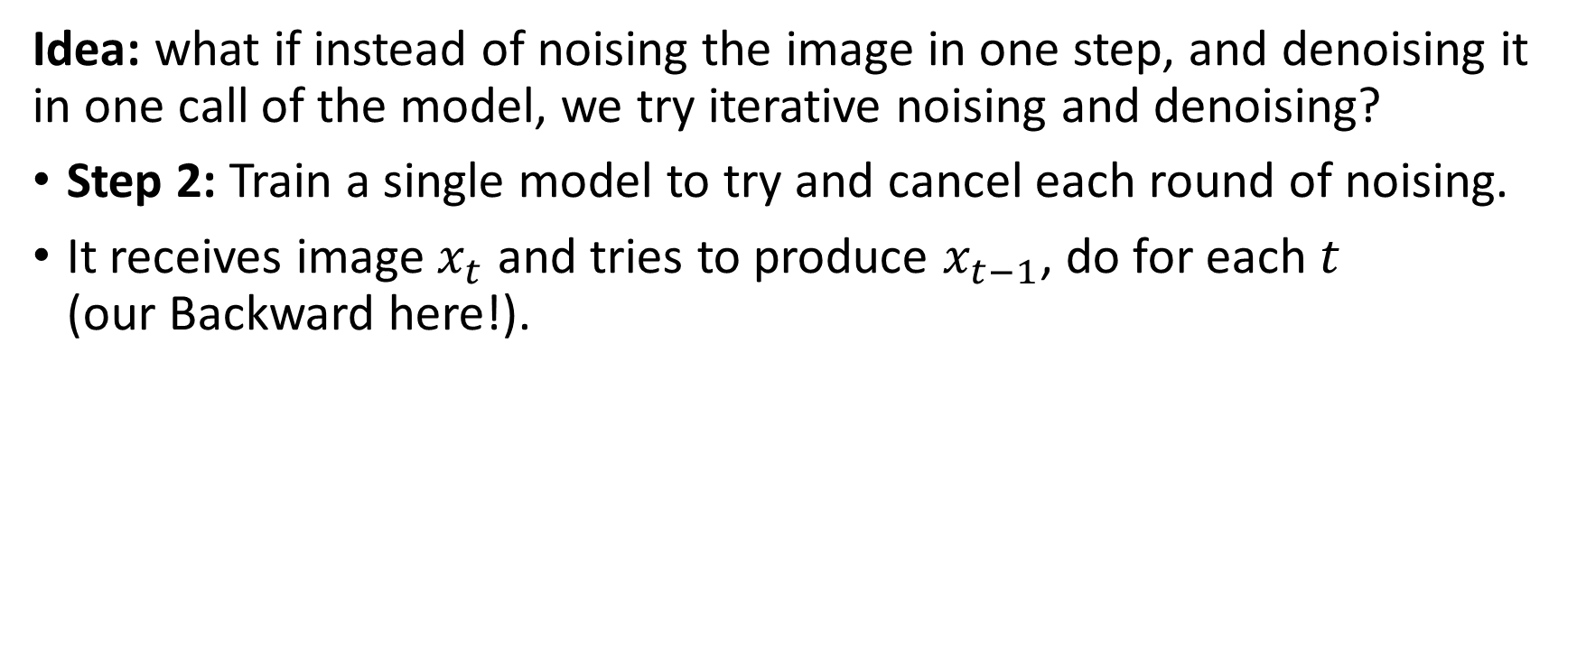
A (not so?) crazy idea
Idea: what if instead of noising the image in one step, and denoising it in one call of the model, we try iterative noising and denoising?
Step 2: Train a single model to try and cancel each round of noising.
It receives image $x_{t}$ and tries to produce $x_{t−1}$, do for each $t$ (our Backward here!).

Slide 23
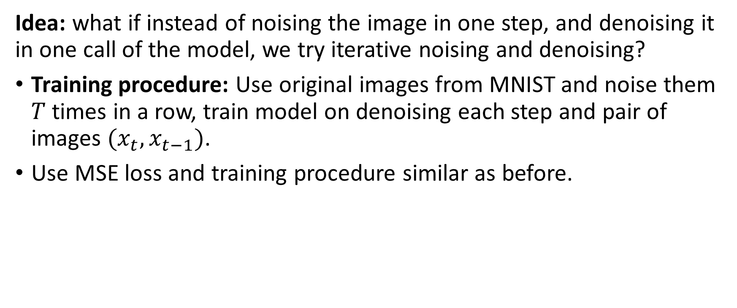
A (not so?) crazy idea
Idea: what if instead of noising the image in one step, and denoising it in one call of the model, we try iterative noising and denoising?
Training procedure: Use original images from MNIST and noise them $T$ times in a row, train model on denoising each step and pair of images $(x_{t}, x_{t−1})$.
Use MSE loss and training procedure similar as before.

Slide 24
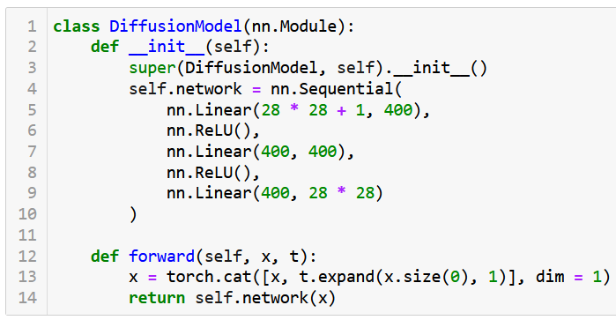
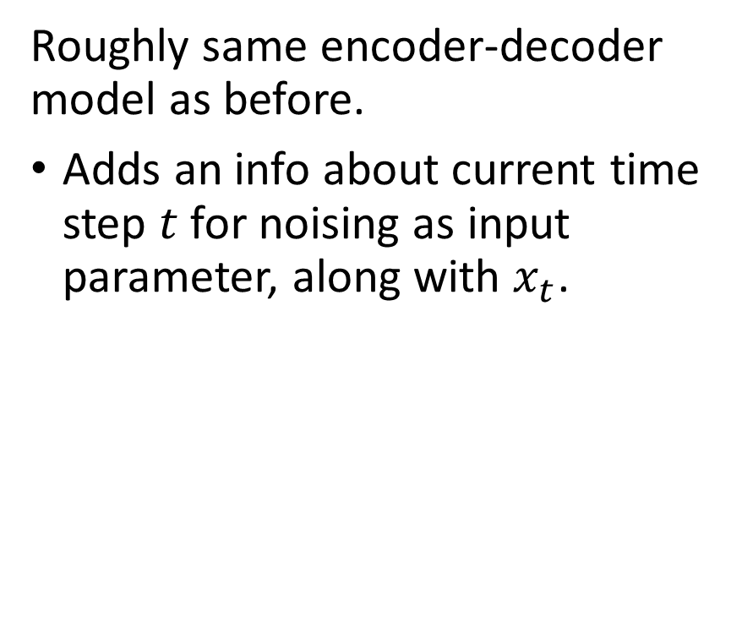
A basic Diffusion Model setup
Roughly same encoder-decoder model as before.
Adds an info about current time step $t$ for noising as input parameter, along with $x_{t}$.

Slide 25
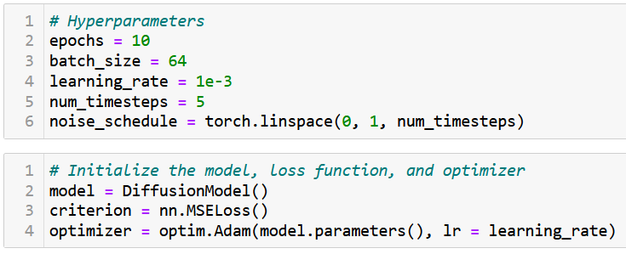
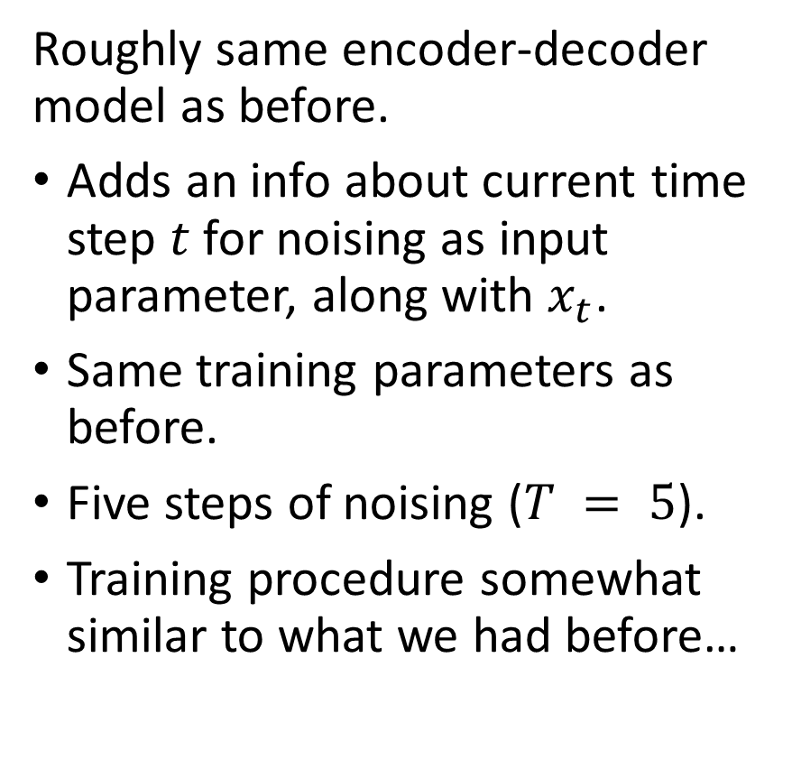
A basic Diffusion Model setup
Roughly same encoder-decoder model as before.
Adds an info about current time step $t$ for noising as input parameter, along with $x_{t}$.
Same training parameters as before.
Five steps of noising ($T = 5$).
Training procedure somewhat similar to what we had before…

Slide 26
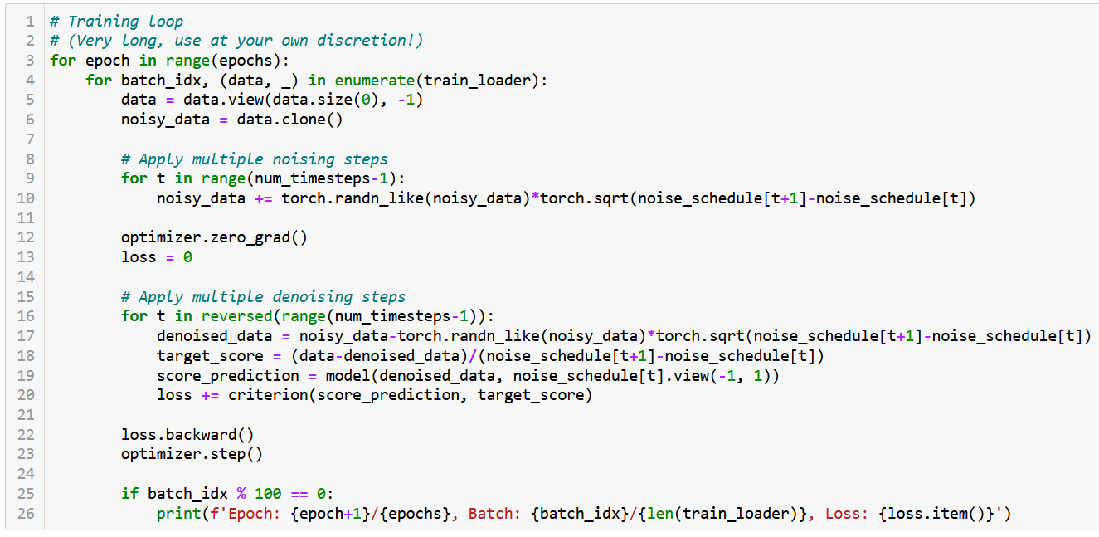

Slide 27
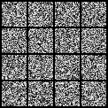
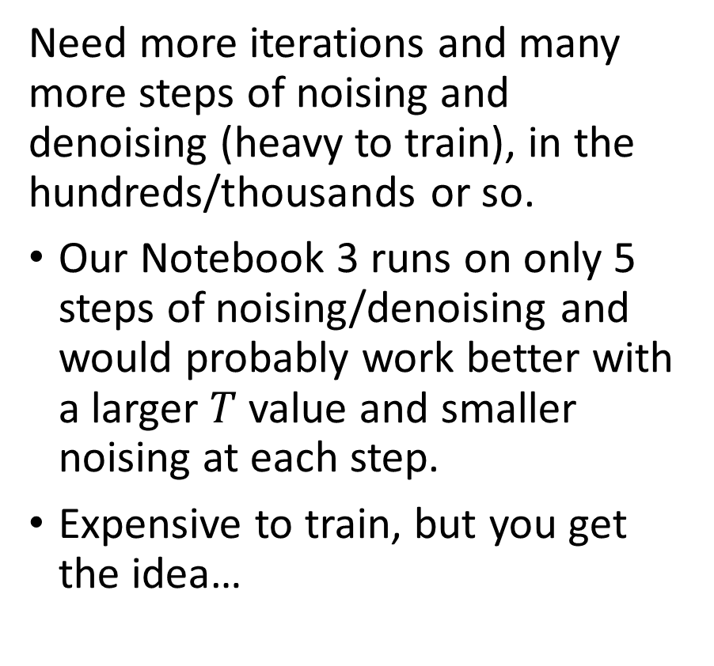
In practice, however…
Need more iterations and many more steps of noising and denoising (heavy to train), in the hundreds/thousands or so.
Our Notebook 3 runs on only 5 steps of noising/denoising and would probably work better with a larger $T$ value and smaller noising at each step.
Expensive to train, but you get the idea…

Slide 28
In practice, however…
We are able to train a model to denoise and eventually obtain a convincing MNIST picture from something that was originally pure noise! Another possible approach to generating images out of thin air?
All advanced ideas from W10 are open! (make it conditional, cyclic, progressive, etc.)

Slide 29
In practice, however…
In practice, however, better to use more advanced CV models, such as UNets, etc.
Learn more in the Computer Vision course on Term 7!
(Or if you already want a pre-trained implementation, readily available…) https://github.com/VSehwag/minimal-diffusion

Slide 30
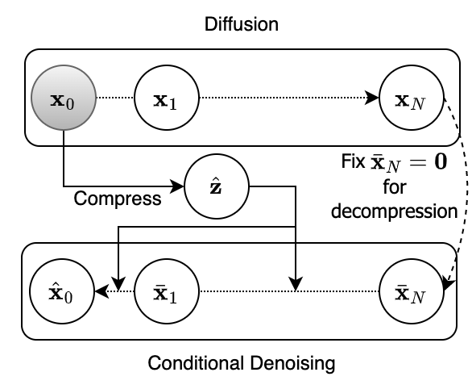
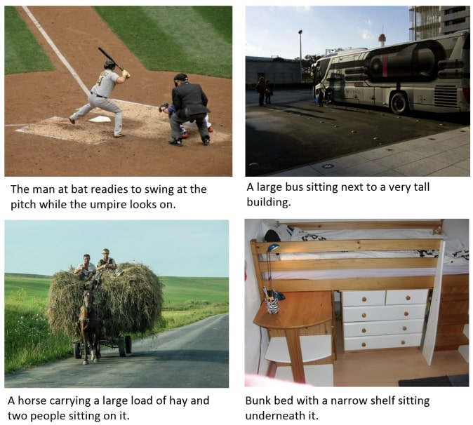
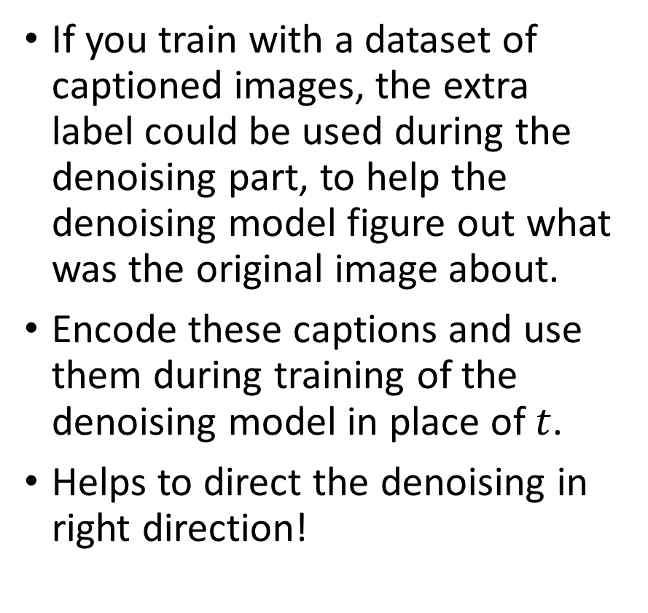
Making it conditional
If you train with a dataset of captioned images, the extra label could be used during the denoising part, to help the denoising model figure out what was the original image about.
Encode these captions and use them during training of the denoising model in place of $t$.
Helps to direct the denoising in right direction!

Slide 31
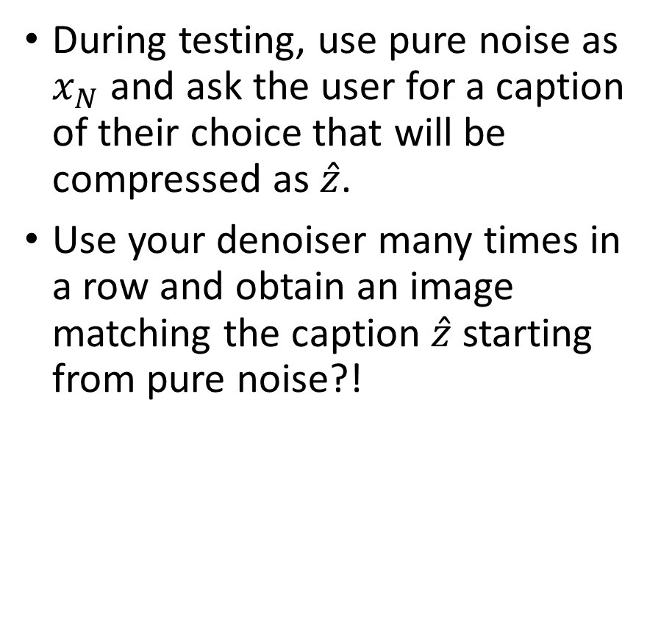
Making it conditional
During testing, use pure noise as $x_{N}$ and ask the user for a caption of their choice that will be compressed as $\hat{z}$.
Use your denoiser many times in a row and obtain an image matching the caption $\hat{z}$ starting from pure noise?!

Slide 32
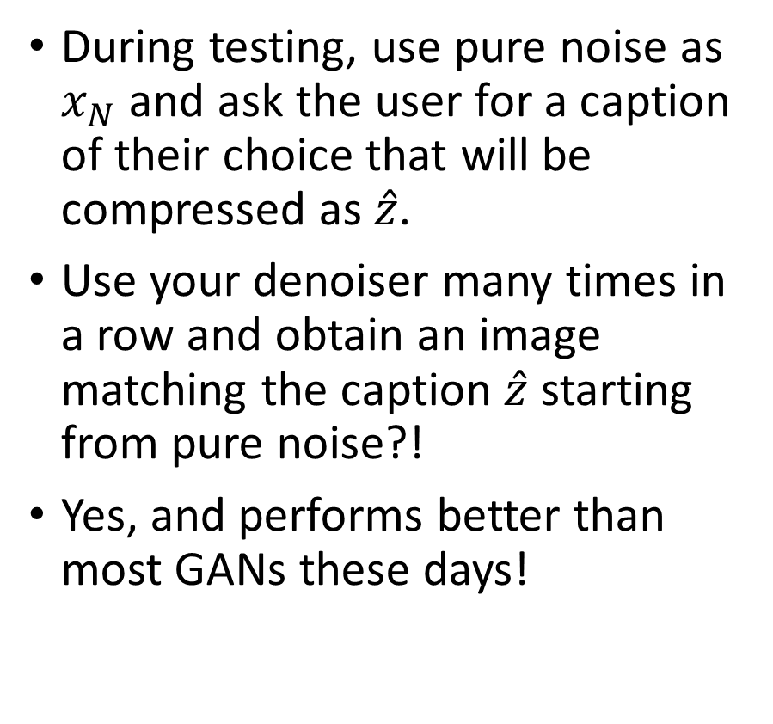
Making it conditional
During testing, use pure noise as $x_{N}$ and ask the user for a caption of their choice that will be compressed as $\hat{z}$.
Use your denoiser many times in a row and obtain an image matching the caption $\hat{z}$ starting from pure noise?!
Yes, and performs better than most GANs these days!

Slide 33
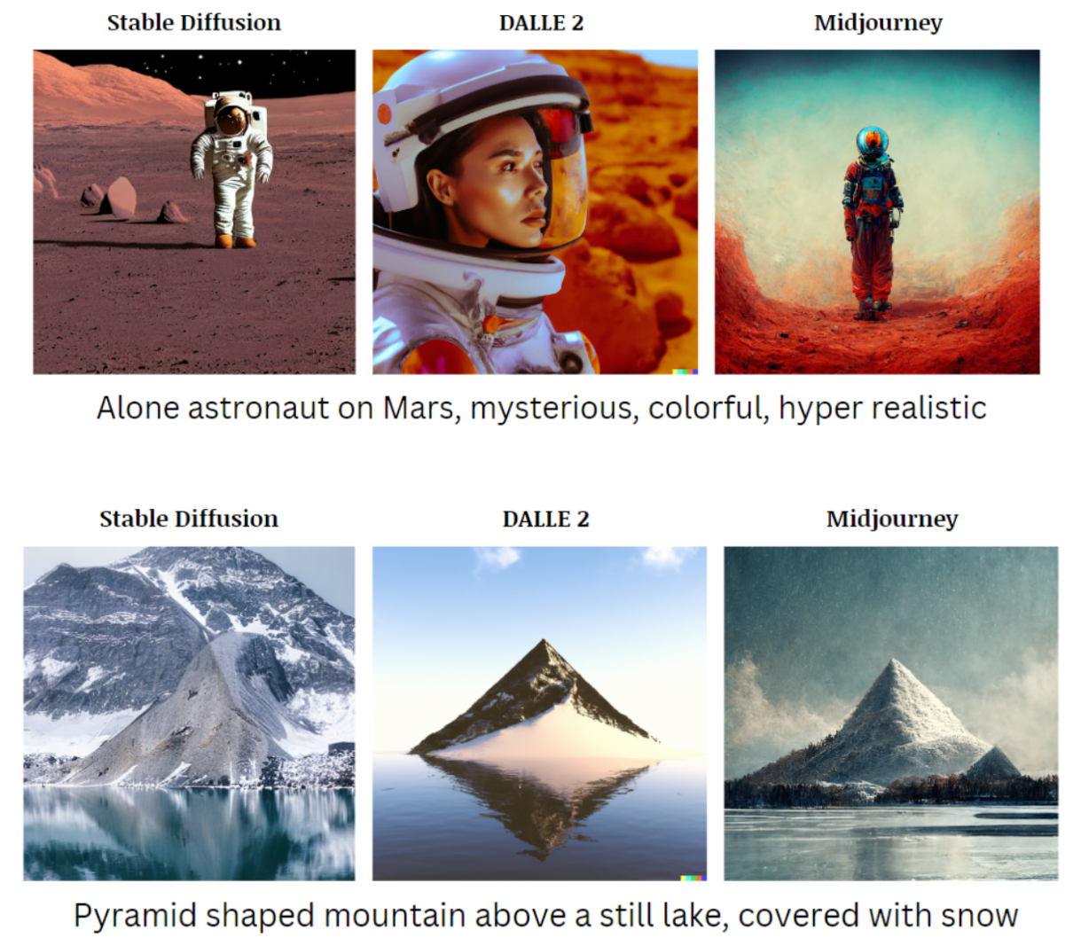
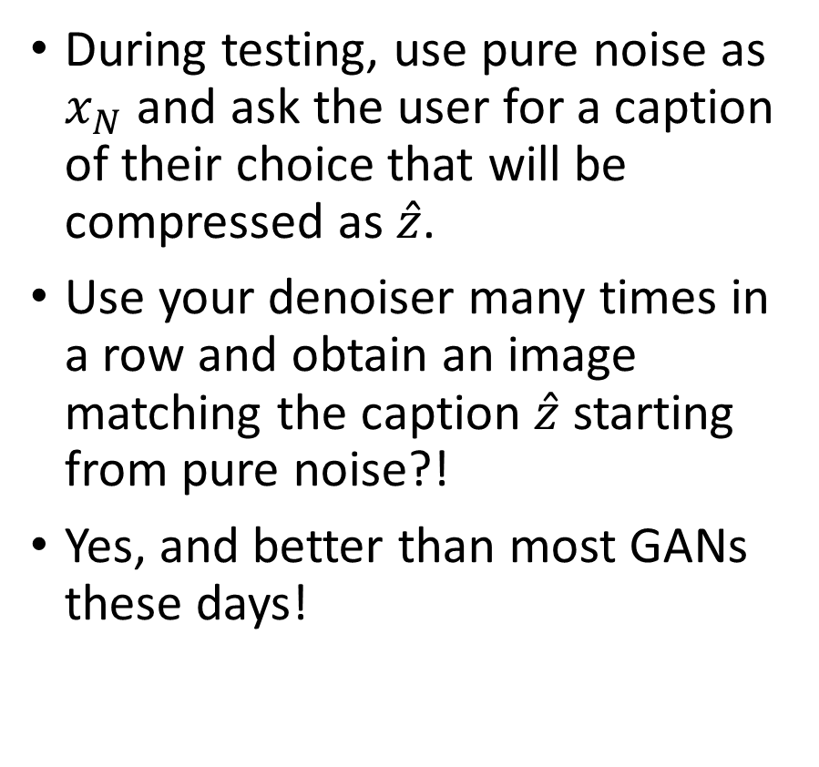
Making it conditional
During testing, use pure noise as $x_{N}$ and ask the user for a caption of their choice that will be compressed as $\hat{z}$.
Use your denoiser many times in a row and obtain an image matching the caption $\hat{z}$ starting from pure noise?!
Yes, and better than most GANs these days!

Slide 34
Diffusion: a good entry point to continue your study of generative models
Stable diffusion: Stable diffusion is a term used to describe a certain property of stochastic differential equations (SDEs) or diffusion processes.
In the context of diffusion models, it refers to the stability of the diffusion process, ensuring that the SDE does not explode or diverge over time.
Stable diffusion processes are crucial in designing diffusion models because they ensure that the generated samples remain within a reasonable range and do not become arbitrarily large or small.

Slide 35
Diffusion: a good entry point to continue your study of generative models
Diffusion models is a promising direction, but many more steps needed to get to a generative model like DALL-E or MidJourney!
DALL-E and MidJourney models are not so-to-speak purely based on diffusion models, but have leveraged intuition from said models.
They would be better described, for now, as generative models based on transformer architectures.
Something for later in Term 7 Computer Vision course?

Slide 36
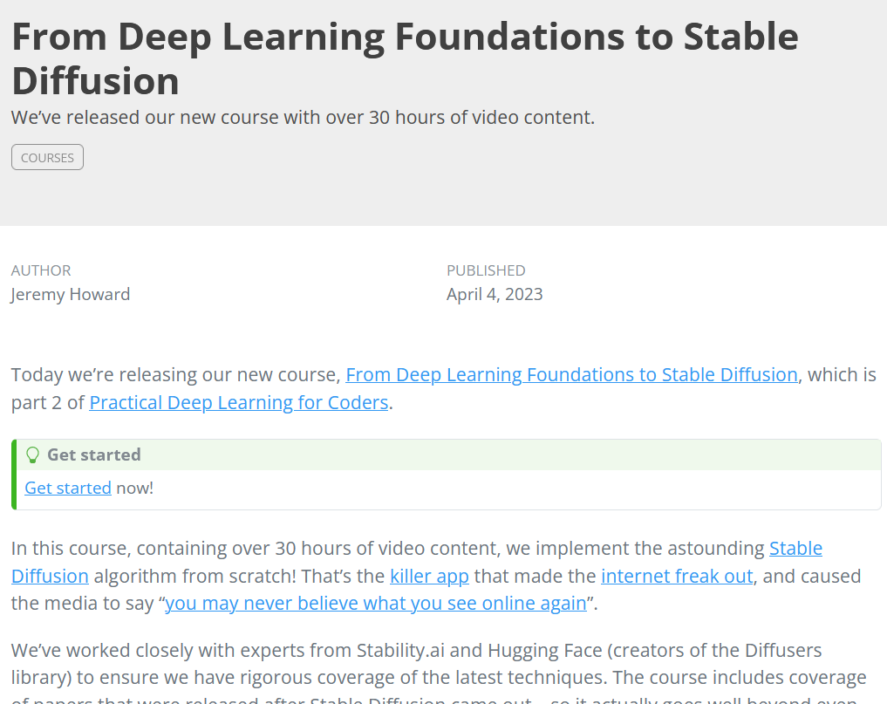
Diffusion: a good entry point to continue your study of generative models
If you cannot wait for Term 7 Computer Vision course…
I guess, this course from Jeremy Howard (Fast.ai), one of the most important AI teachers out there, is probably very nice to take…
https://www.fast.ai/posts/part2-2023.html

Slide 37
Conclusion
What is a Stochastic Differential Equation?
What are typical uses of SDEs?
Can I noise images progressively using SDEs?
Can you train a denoising autoencoder model that removes SDE noise from images?
What is the diffusion process and how to use it to train diffusion models?
What are the architectures of DALL-E and Midjourney models?

Slide 38
Learn more about these topics
Out of class, for those of you who are curious
The one paper, usually cited for Diffusion models [Ho2020] J. Ho, X. Chen, A. Srinivas, Y. Duan, and P. Abbeel, “Denoising diffusion probabilistic models. Advances in Neural Information Processing Systems”, 2020. https://arxiv.org/abs/2006.11239
[Dhariwal2021] P. Dhariwal, and A. Nichol, “Diffusion models beat GANs on ImageNet.”, 2021. https://arxiv.org/abs/2105.05233

